Slide 1
DS 6373: Unit 2 Live Session

Slide 2
Explanation: VXBAR CODE / Unit 1 Breakout Code

Slide 3
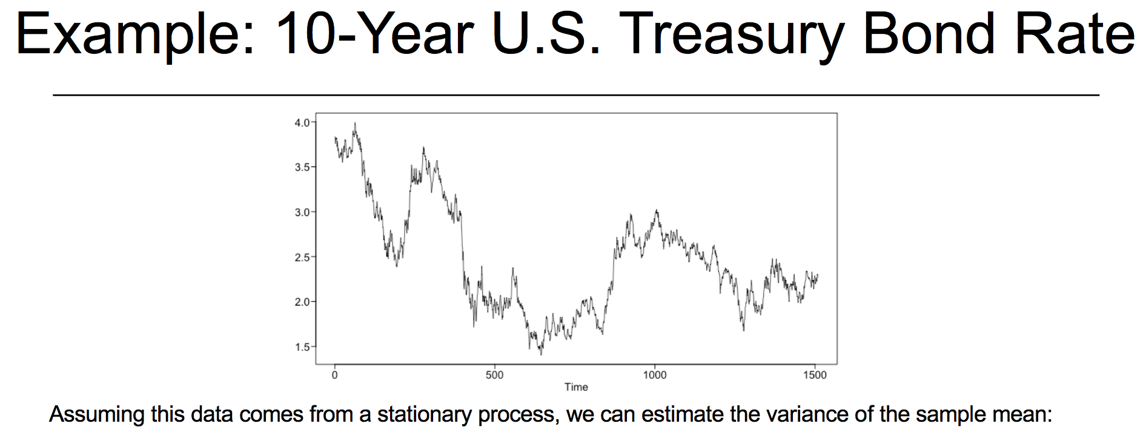
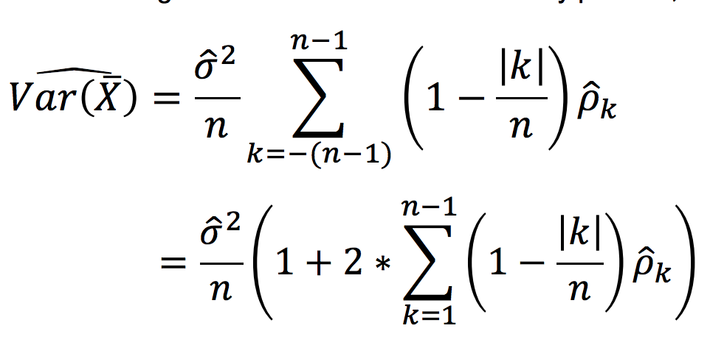
Variance Code
xdf = read.csv(file.choose(),header = TRUE)
x = as.numeric(paste(xdf$Adj.Close))
x = x[!is.na(x)]
n=length(x) #n = 1509
nlag=1508 #n-1
gamma0=var(x)*(n-1)/n
aut=acf(x,lag.max=1508) #n-1
sum=0
for (k in 1:nlag) {sum=sum+(1-k/n)*aut$acf[k+1]*gamma0}
vxbar=2*sum/n+gamma0/n #note the mult of sum by 2
vxbar

Slide 4
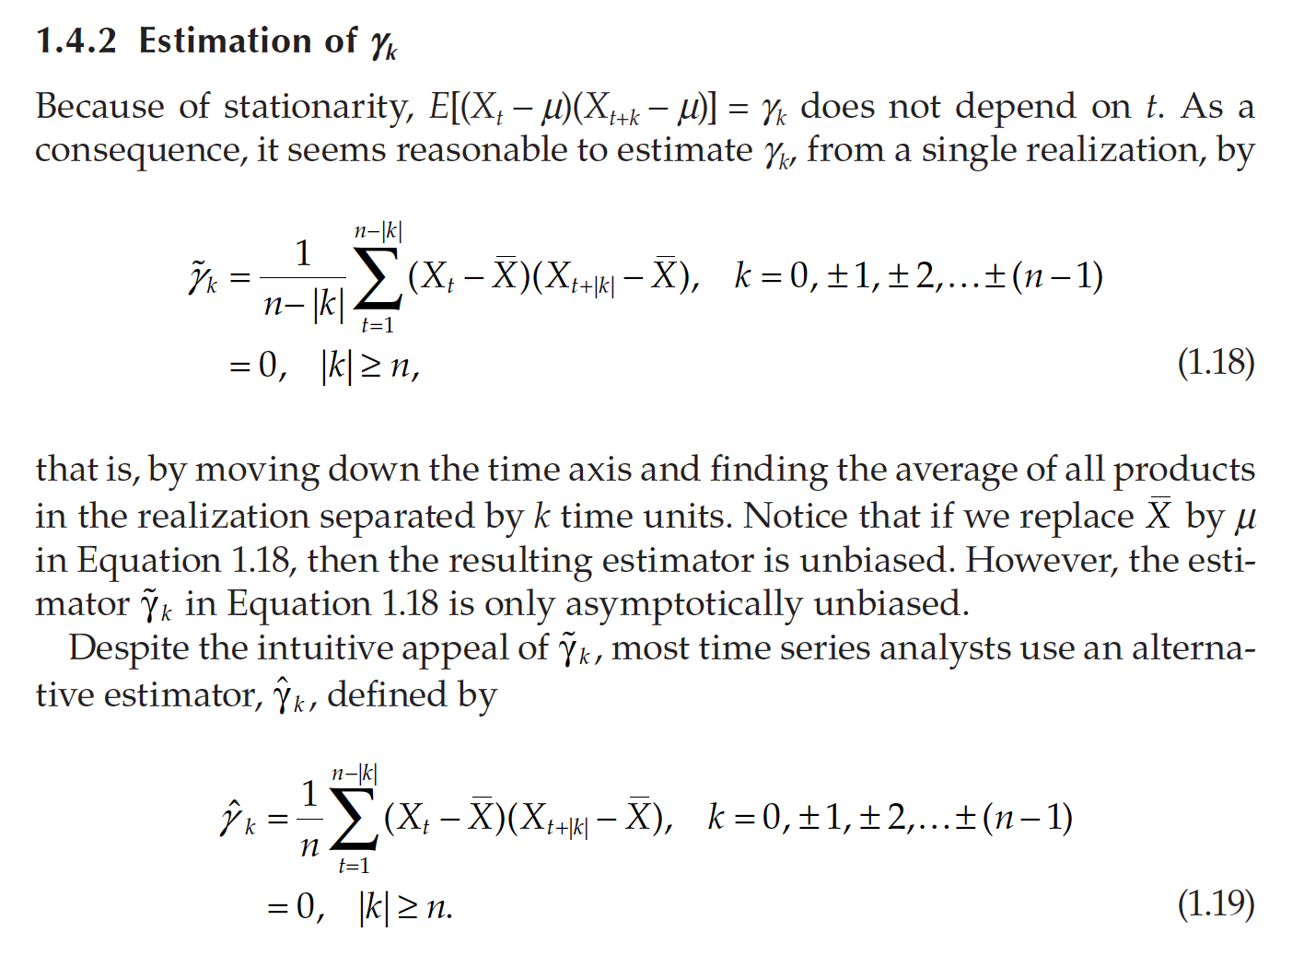
Estimation

Slide 5
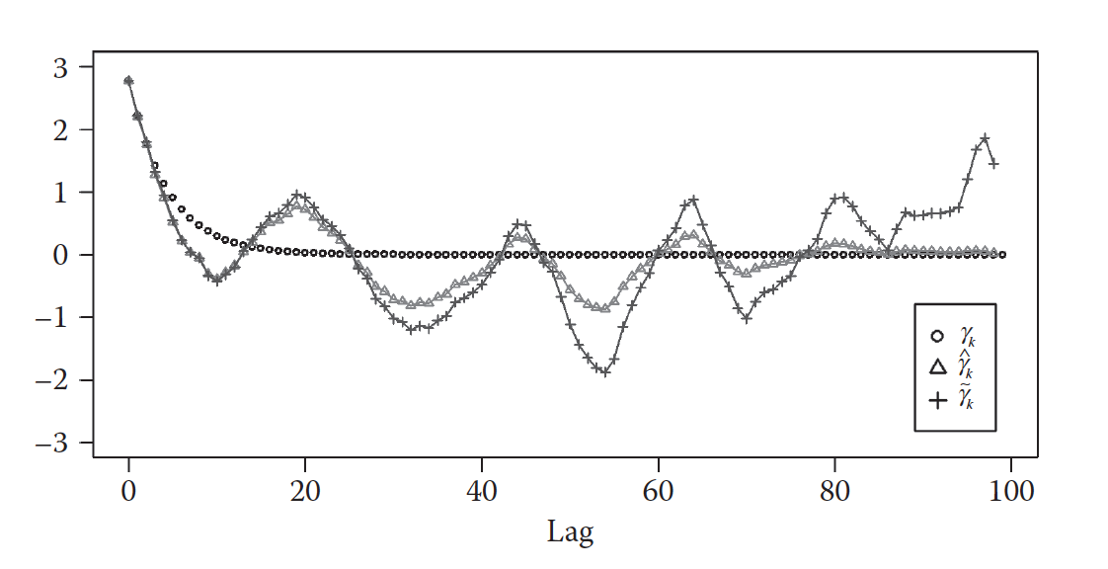
Estimation of Autocovariance

Slide 6
Some Questions from PPT
1. How does changing amplitude affect the spectral density plots?
a = gen.sigplusnoise.wge(1000,coef = c(1,0), freq = c(.2,0))
parzen.wge(a)
a = gen.sigplusnoise.wge(1000,coef = c(10,0), freq = c(.2,0))
parzen.wge(a)
a = gen.sigplusnoise.wge(1000,coef = c(15,0), freq = c(.2,0))
parzen.wge(a)
2. Link between realization and spectral density. Examples
a = gen.sigplusnoise.wge(100,coef = c(1,0), freq = c(.2,0), vara = .2)
parzen.wge(a)
a = gen.sigplusnoise.wge(100,coef = c(1,0), freq = c(.4,0), vara = .2)
parzen.wge(a)
a = gen.sigplusnoise.wge(100,coef = c(1,1), freq = c(.2,.4), vara = .2)
parzen.wge(a)

Slide 7
Breakout 1

Slide 8
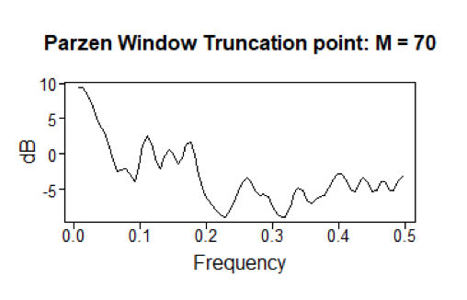
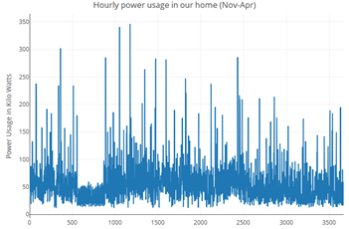
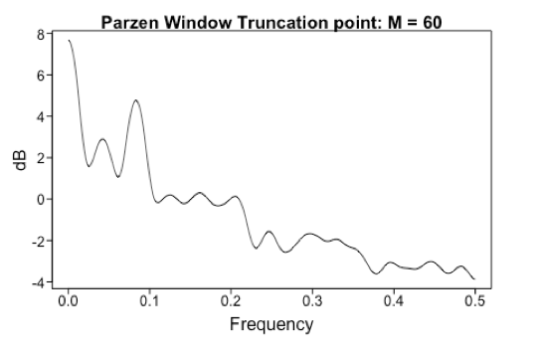
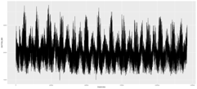
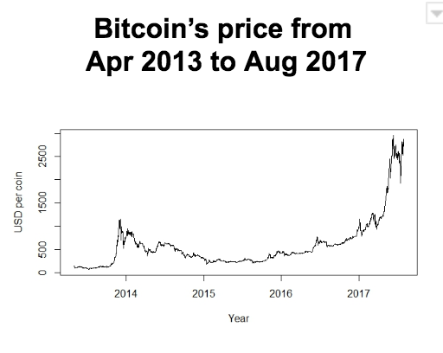
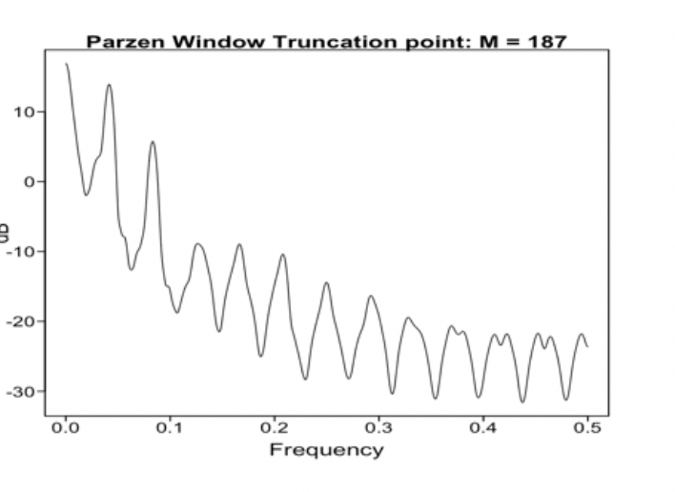
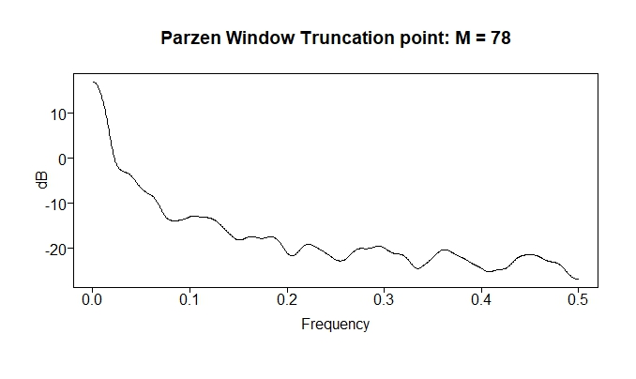
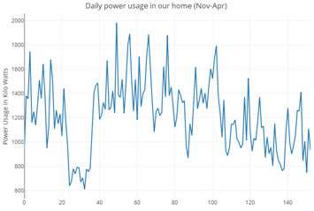
Match’em Up!
1
a
2
b
3
c
4
d

Slide 9
Match’em Up!
1
d
2
a
3
b
4
c

Slide 10
End Break Out 1

Slide 11
Breakout 2

Slide 12
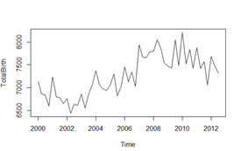
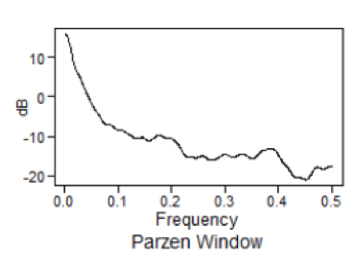
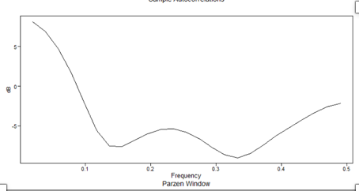
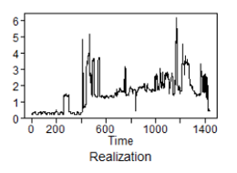
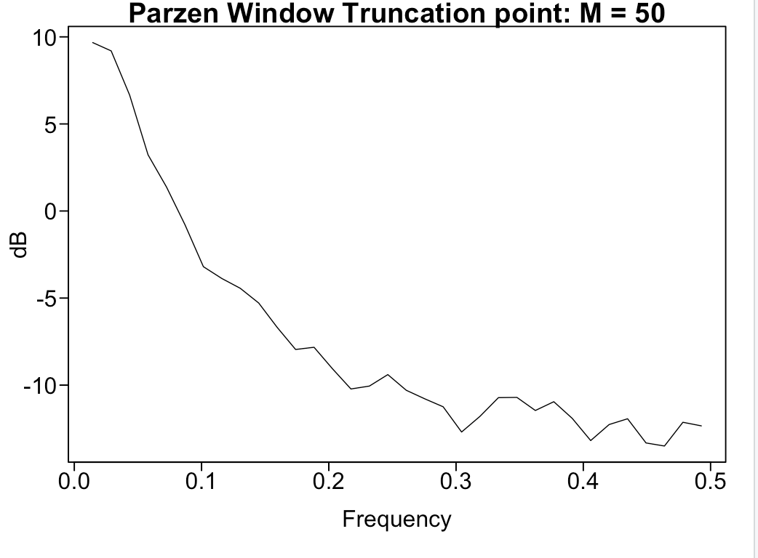
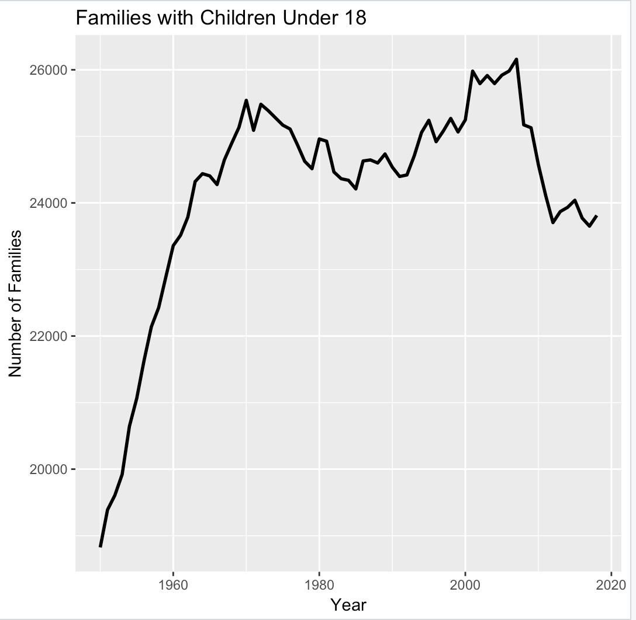
Match’em Up Part 2
New Zealand Births by Quarter
a
1
24 hours of minutely data
b
2
3
c
d
4

Slide 13
Match’em Up Part 2
24 hours of minutely data
b
1
New Zealand Births by Quarter
2
a
3
d
4
c

Slide 14
End Break Out 2

Slide 15
Aggregating

Slide 16
Power Usage By Minute for 6 months

Slide 17
Hourly Power Usage

Slide 18
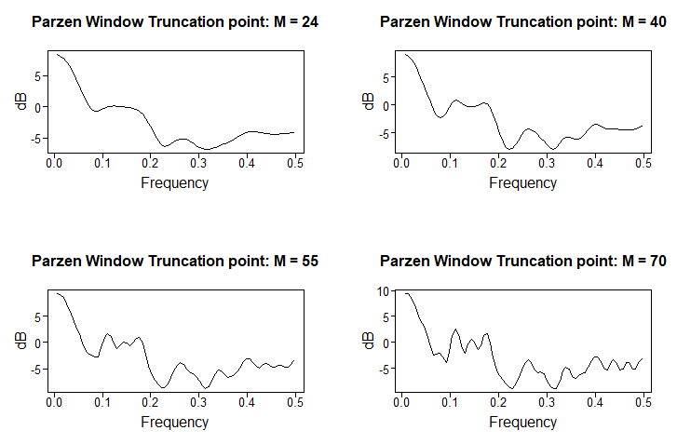
Daily Power Usage

Slide 19
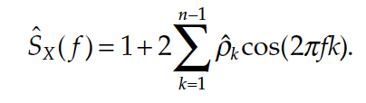
Question … What should the Spectral Density of White Noise Look Like?

Slide 20
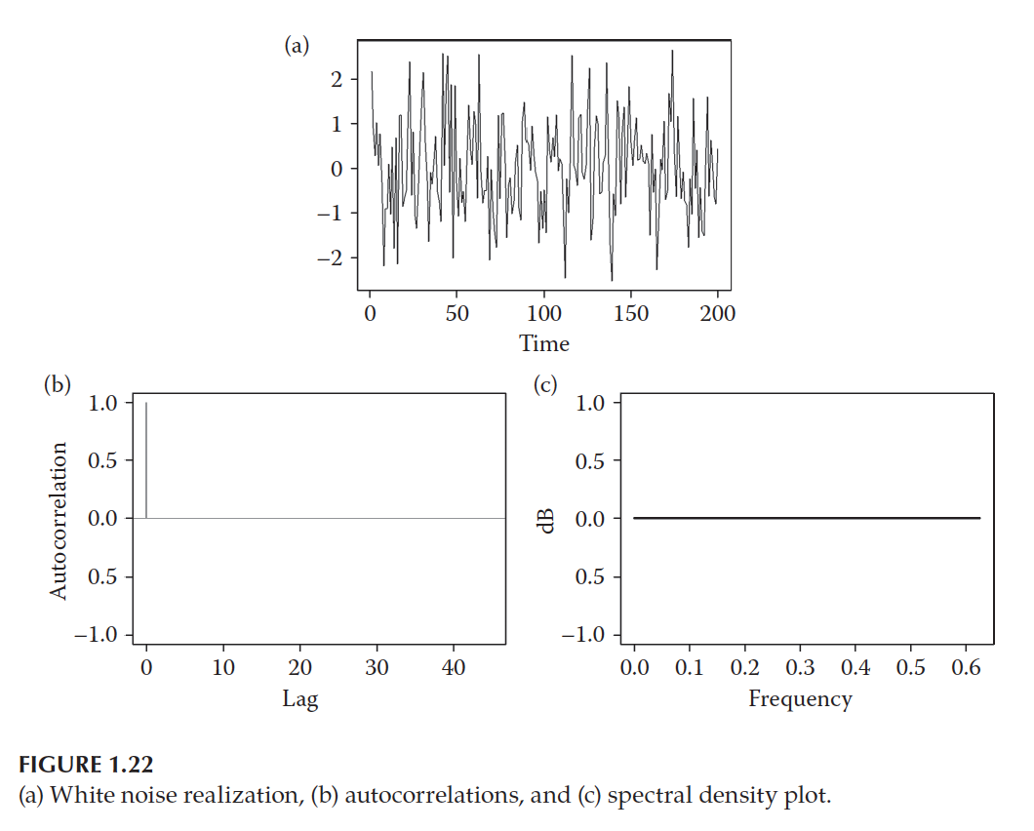
Why is the True Spectral Density Shown Below Always at Zero?

Slide 21
Generate 1000 observation of from a white noise process and find the sample spectral density using a Parzen Window.

Slide 22
Break Out 3

Slide 23
Break Out
Load the Data
Filter the data to get only the sales for Store 8 and Item 1.
Stor8Item1 = Walmart %>% filter(item == 1 & store == 8)
Does the data come from a stationary process? Make sure and address all 3 conditions.
The client believes there is yearly and weekly seasonality in the data. Is there evidence of this with respect to the spectral density?

Slide 24
Extras

Slide 26
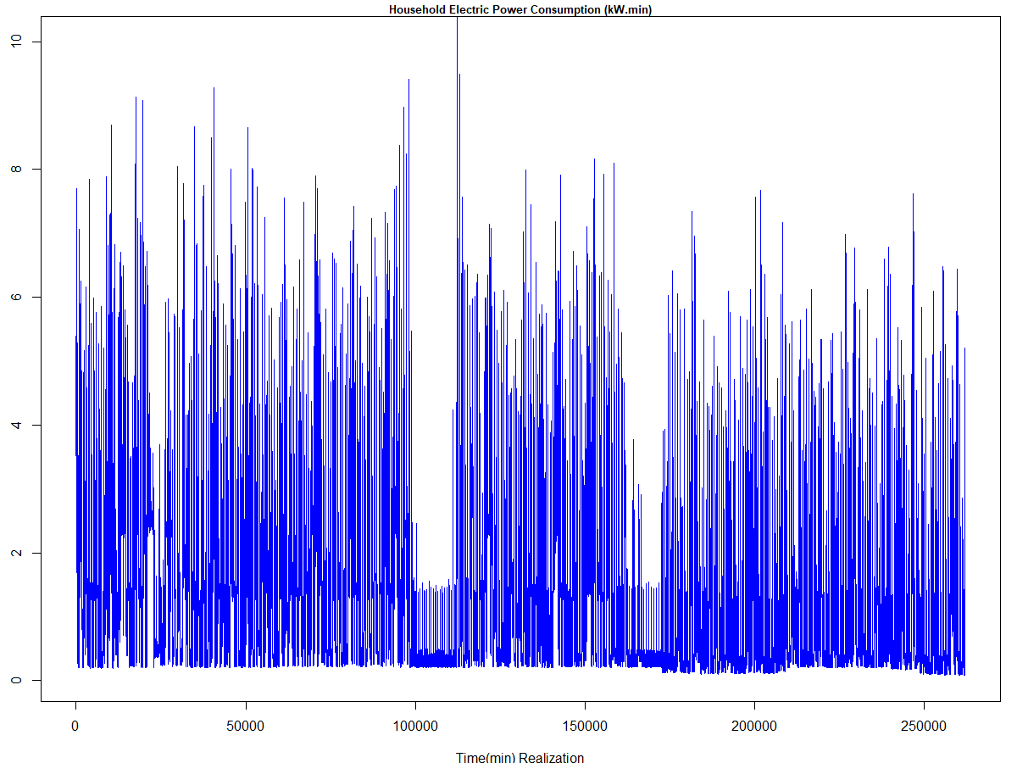
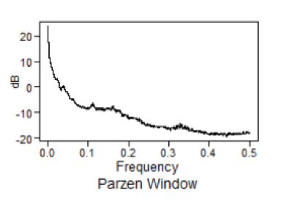
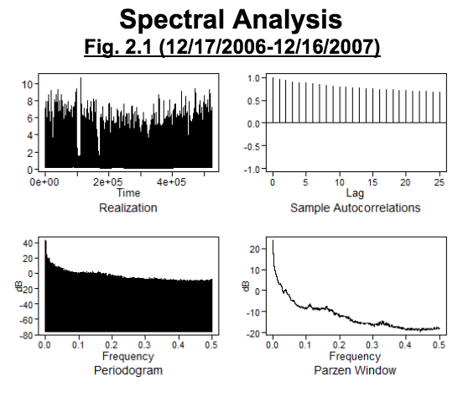
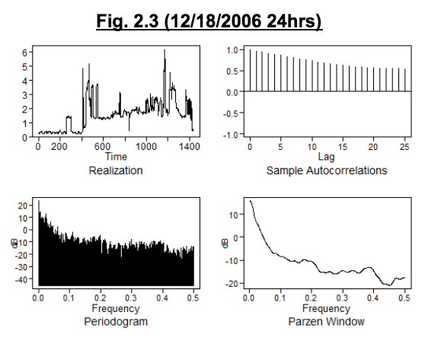
1 Year
24 Hours

Slide 27

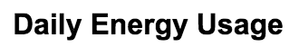
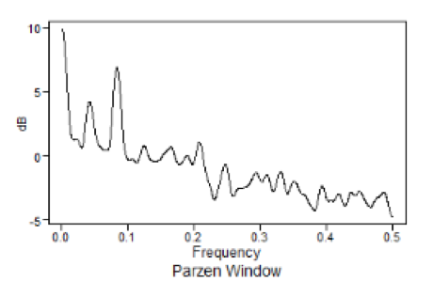
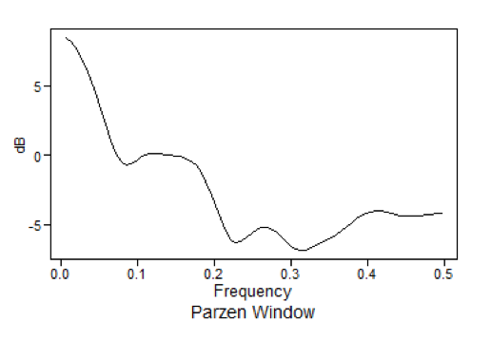
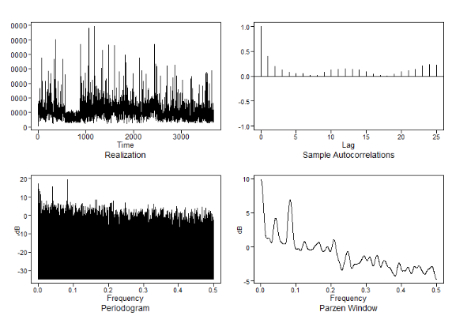
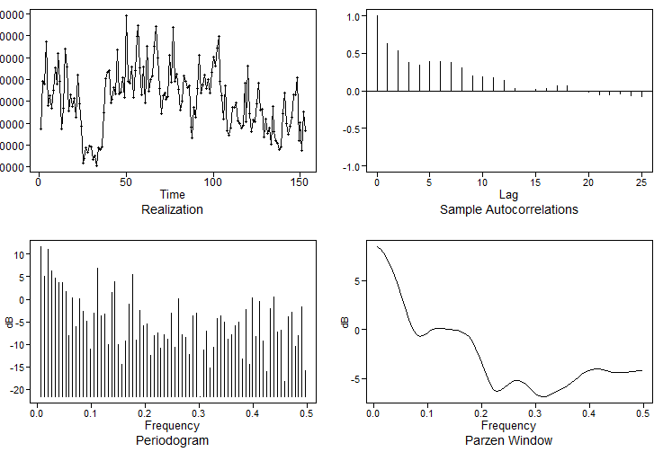

Slide 28
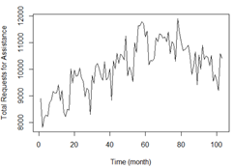
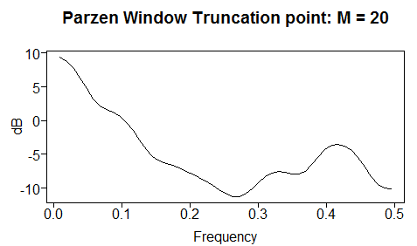
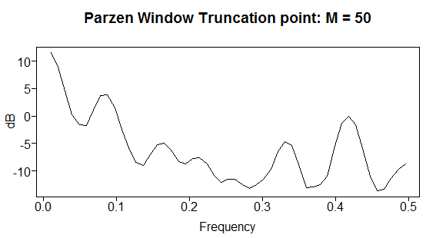
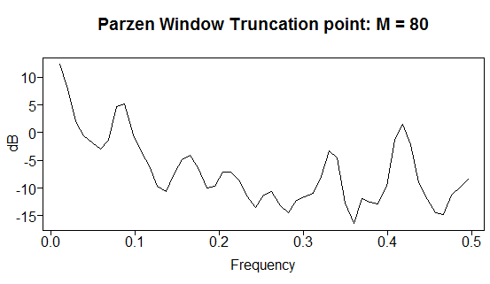

Slide 30
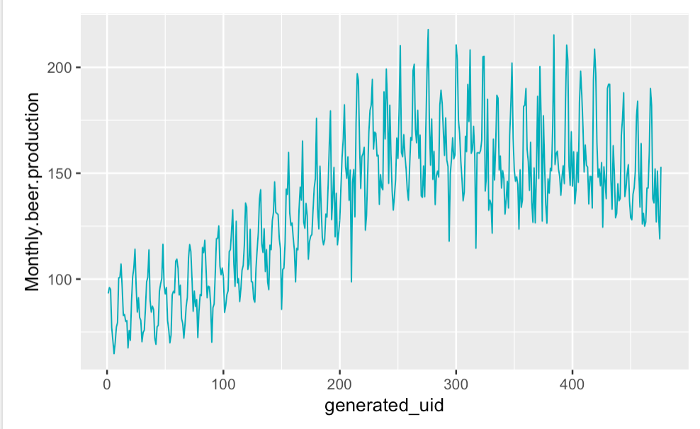
Monthly Beer Production

Slide 31
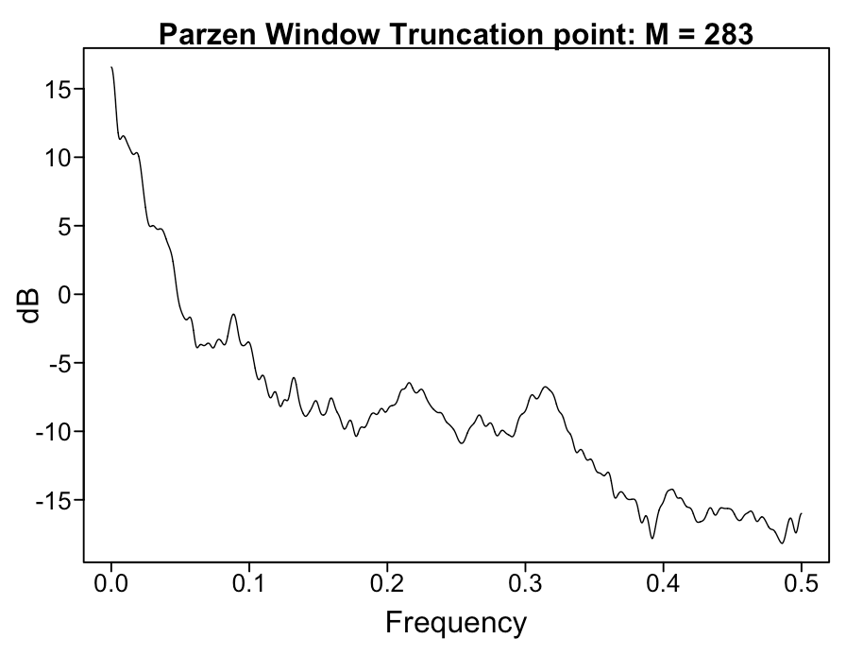
Power Usage By Minute for 2 Weeks
plotts.wge(homepowerusage$usageValue[1:20160])
parzen.wge(homepowerusage$usageValue[1:20160])

